Slide 1
Intelligent Agent for Othello
Blake Gerold & Colin Jensen & Jaehyeok Choi

Slide 2
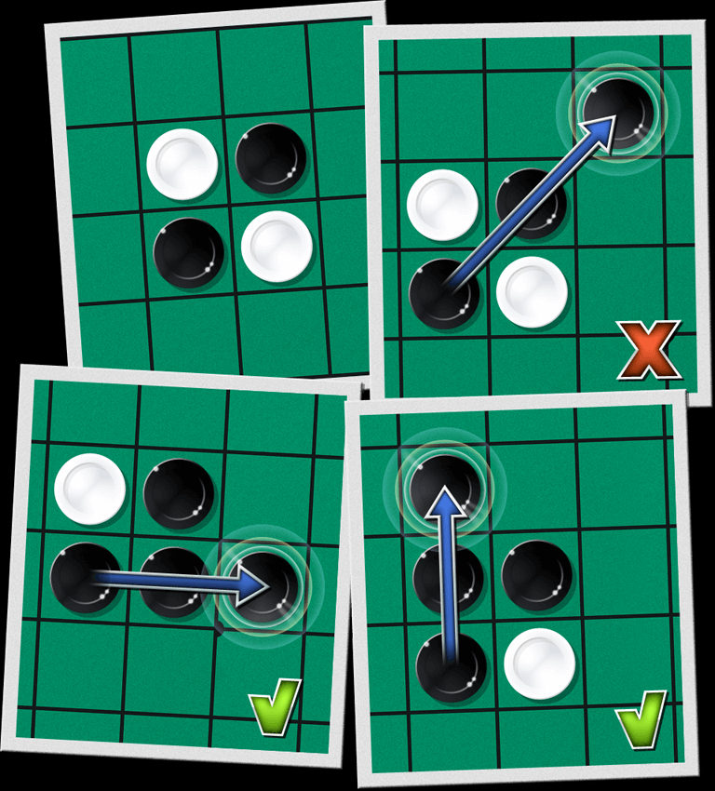
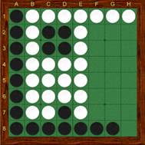
What is Othello?
-Why we choose it
-Interesting rules for scoring the game
-Go from completely losing to winning quickly
Source: https://info.lite.games/en/support/solutions/articles/60000688960-othello-rules
Notes:
Blake
-Simple game
-Interesting rules
-Strategizing is hard

Slide 3
What was our goal?
Our goal was to develop an intelligent agent for game Othello.
We used reinforced learning as our first approach.
Memory Issues
Minimax with alpha beta pruning methods
Notes:
Blake
Our goal was to develop an intelligent agent for game OthelloTo achieve this goal, first our team approached this problem with reinforced learning in mind … BUT!!
Because the game tree for othello is WAY bigger than most of the games that we have examined for reinforcement learning examples, when we run the model, we were getting memory errors…
Since reinforcement learning would require us to have more memory than we could actually afford, we decided to use minimax and alpha beta pruning methods for this example.
Spoilers - Reinforcement learning failed due to memory issue …Our goal was to develop an intelligent agent for game OthelloTo achieve this goal, first our team approached this problem with reinforced learning in mind … BUT!!
Because the game tree for othello is WAY bigger than most of the games that we have examined for reinforcement learning examples, when we run the model, we were getting memory errors…
Since reinforcement learning would require us to have more memory than we could actually afford, we decided to use minimax and alpha beta pruning methods for this example.
Spoilers - Reinforcement learning failed due to memory issue …

Slide 4
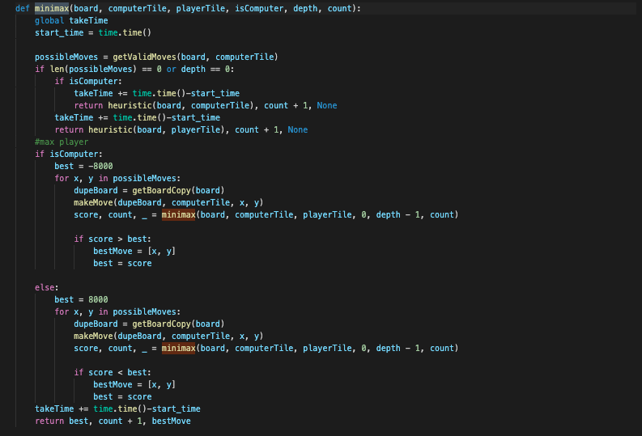
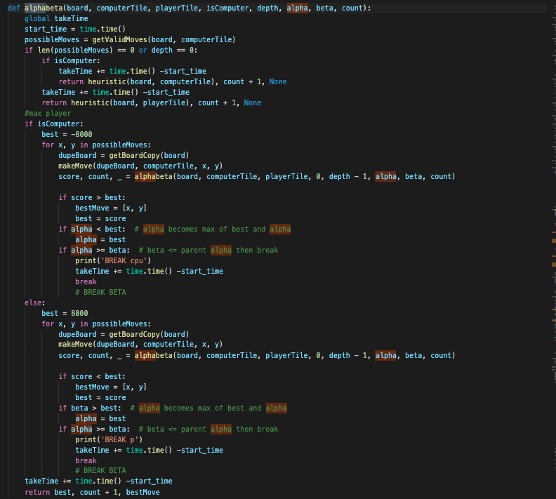
MINIMAX && AB Pruning
Notes:
Colin
Couldn't do utility
Had to adapt heuristic
Adapted starter code and tic-tac-toe
Starter othello wasn’t class based, allowed to chose piece
Had to adjust code to account for othello limitations on moves
Note print statements are removed

Slide 5
Code DEMO Both Codes
As game progress, because the move that a player can be will be limited, the game tree will become significantly smaller. This will cause significant decrease in computing time.
Game Tree Analysis - how the game tree expands beginning, mid, and end of the game
Alpha Beta Pruning greatly reduces the game tree for Othello and helps to get the lower depth which helps to win better. Since Othello can be “flipped” very fast, it is very important for model to explore very close to terminal nodes, which greatly increases the benefit of using alpha beta pruning.
Notes:
Jae

Slide 6
Acknowledgement
Our template code is from http://inventwithpython.com/chapter15.html
To implement the method of our choice, the above code is modified to implement certain methods - such as reinforcement learning, minimax and alpha beta pruning

